Slide 1
Selected topics in AI 2 Active Learning Task 1

Slide 2
Project analysis slide 2
Project data
Iris dataset
Mushroom datasets
Stroke Prediction Dataset
This dataset includes descriptions of hypothetical 8124 samples corresponding to 23 species of gilled mushrooms in the Agaricus and Lepiota Family Mushroom drawn from The Audubon Society Field Guide to North American Mushrooms (1981). Each species is identified as definitely edible, definitely poisonous, or of unknown edibility and not recommended. This latter class was combined with the poisonous one. The Guide clearly states that there is no simple rule for determining the edibility of a mushroom; no rule like "leaflets three, let it be'' for Poisonous Oak and Ivy
It consists of 150 samples of iris flowers, each containing measurements of the sepal length, sepal width, petal length, and petal width. The goal is to classify each sample into one of three species: setosa, versicolor, or virginica, based on the four measurements
This dataset is unbalanced, it’s used to predict whether a patient is likely to get stroke based on the input parameters like gender, age, various diseases, and smoking status. Each row in the data provides relevant information about the patient. Contains 5110 observations with 12 attributes

Slide 3
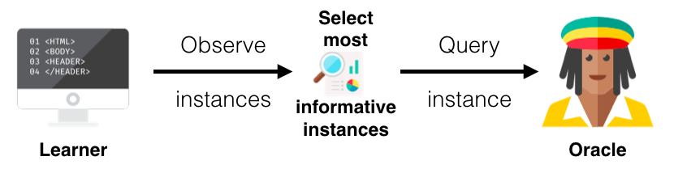
Project analysis slide 2
Query strategies
We use 4 Query strategies in the project :
Uncertainty Sampling
Entropy Sampling
Random Sampling
Margin Sampling

Slide 4
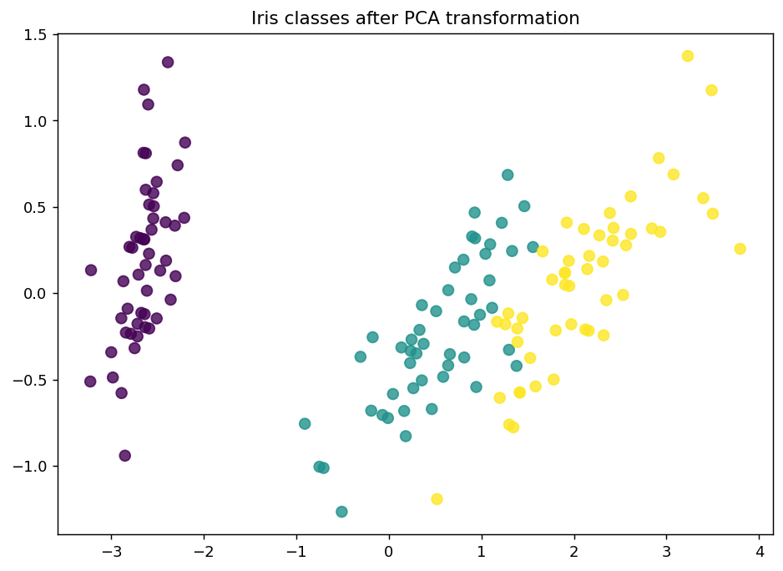
Project analysis slide 2
Iris dataset
Training size : 3
Estimator : KNN (k = 3)

Slide 5
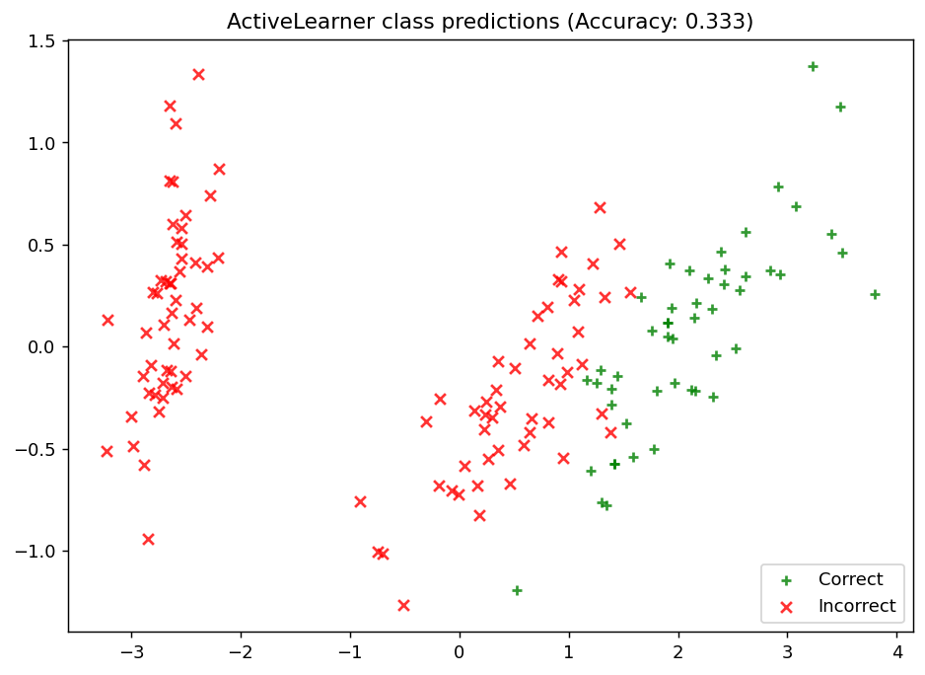
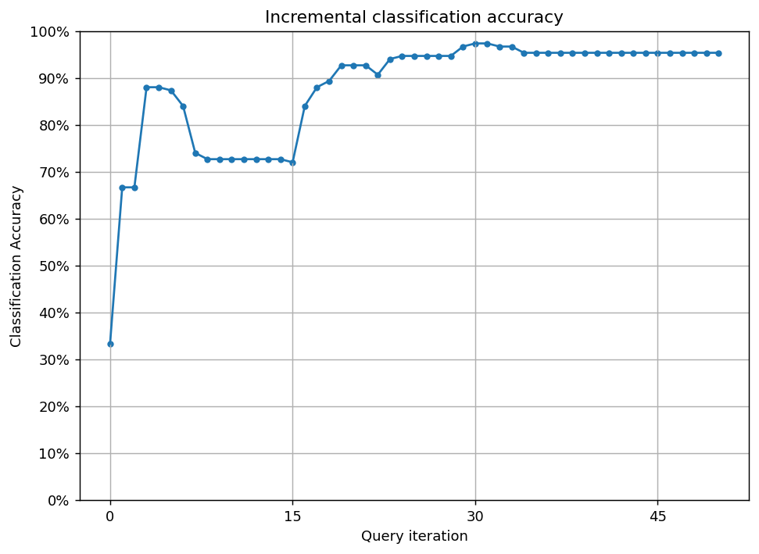
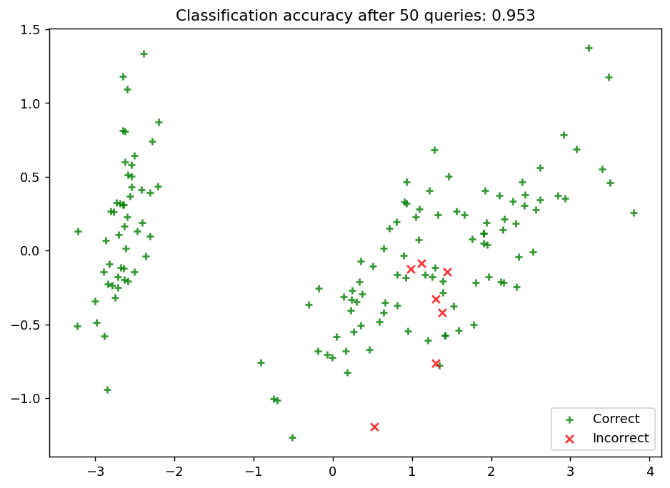
Project analysis slide 2
Iris dataset
Applying Active learning using uncertainty sampling strategy:

Slide 6
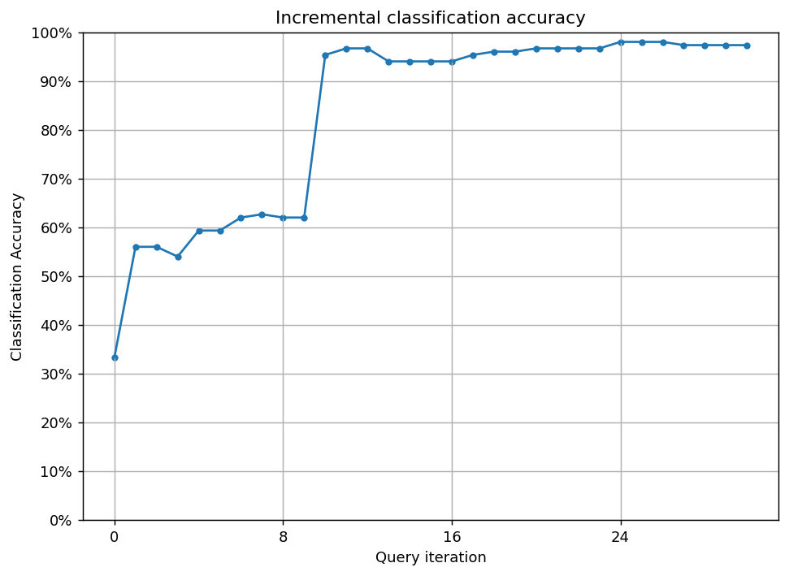
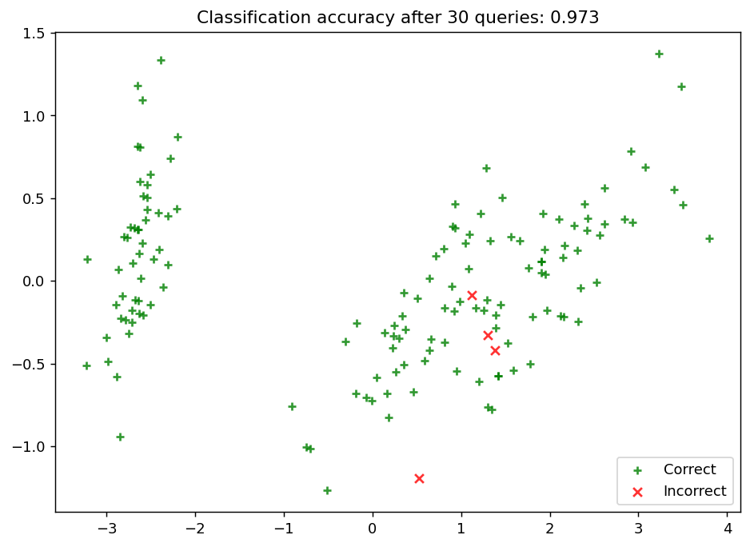
Project analysis slide 2
Iris dataset
Applying Active learning using random sampling strategy:

Slide 7
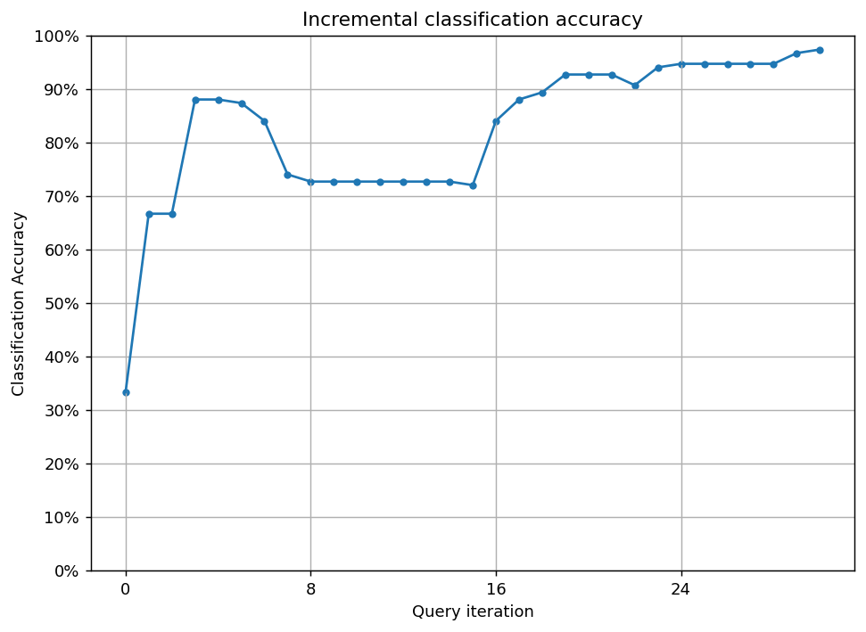
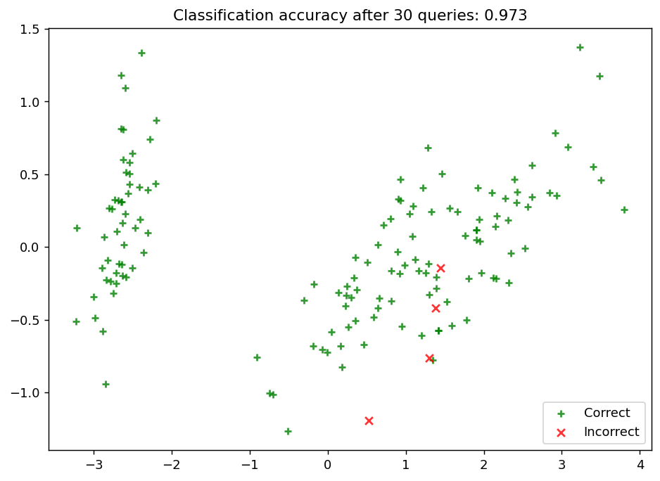
Project analysis slide 2
Iris dataset
Applying Active learning using entropy sampling strategy:

Slide 8
Project analysis slide 2
Iris dataset
Applying Active learning using margin sampling strategy:

Slide 9
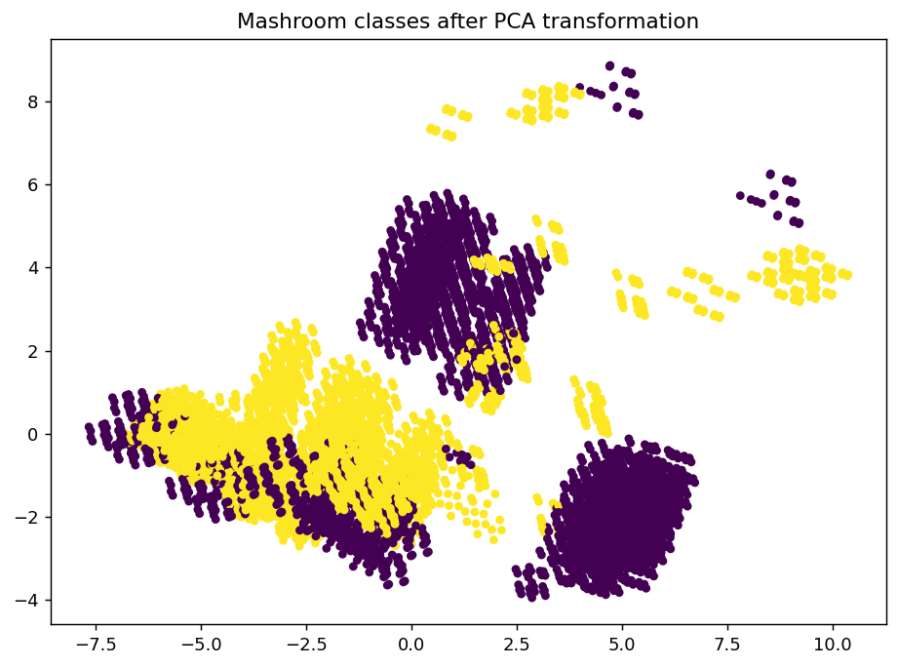
Project analysis slide 2
mushrooms dataset
Training size : 5
Estimator : DecisionTreeClassifier(criterion="entropy", max_depth = 7,min_samples_split=5)

Slide 10
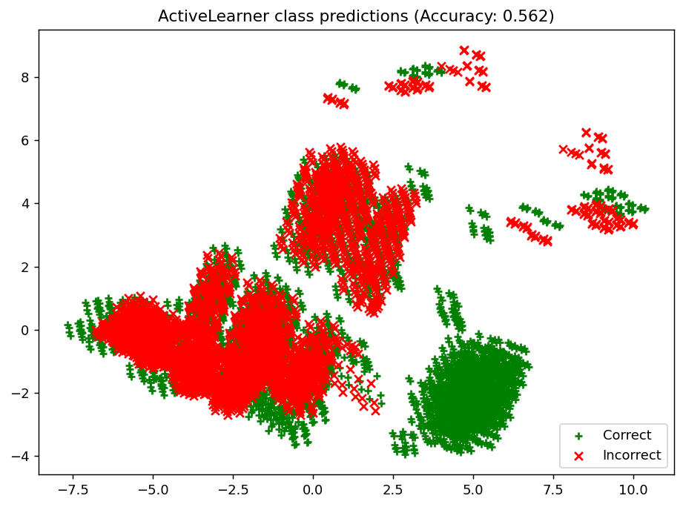
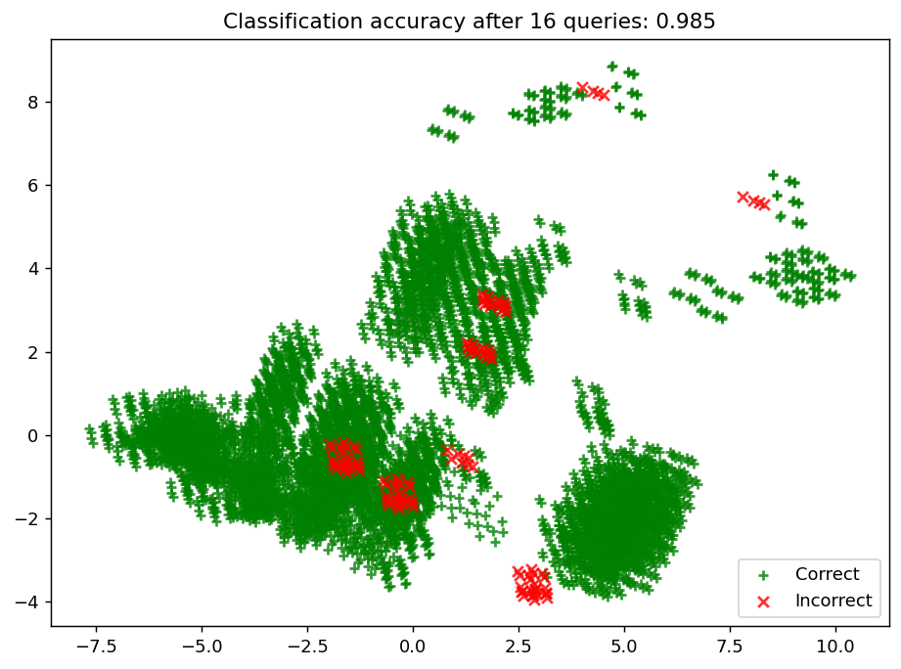
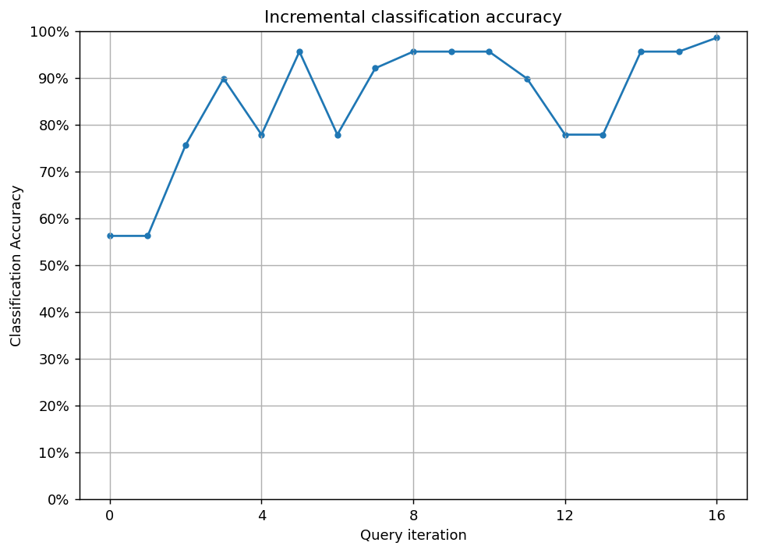
Project analysis slide 2
mushrooms dataset
Applying Active learning using uncertainty sampling strategy:

Slide 11
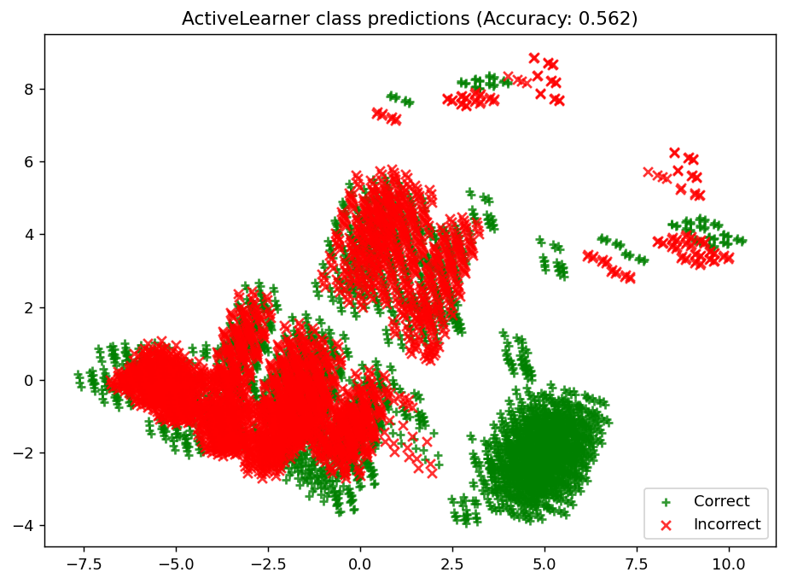
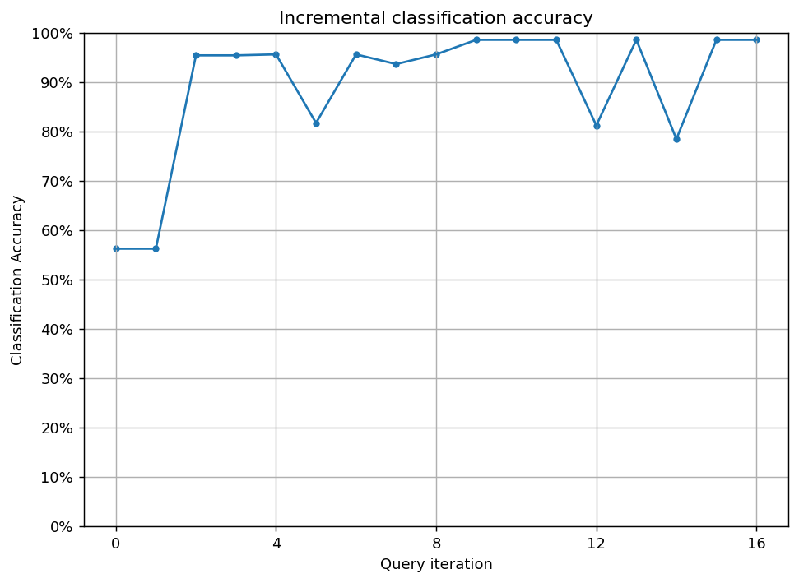
Project analysis slide 2
mushrooms dataset
Applying Active learning using random sampling strategy:

Slide 12
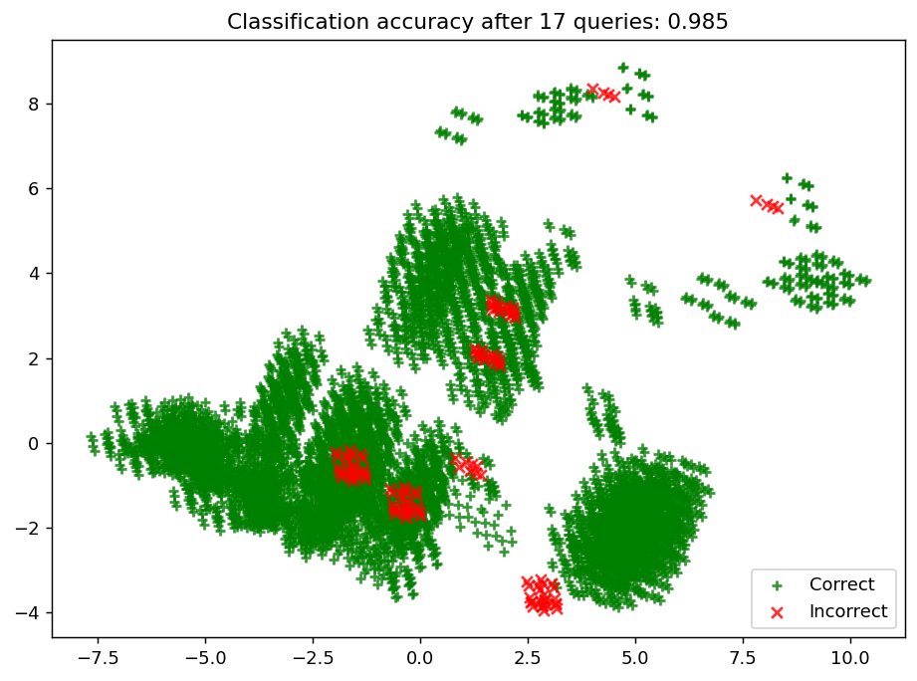
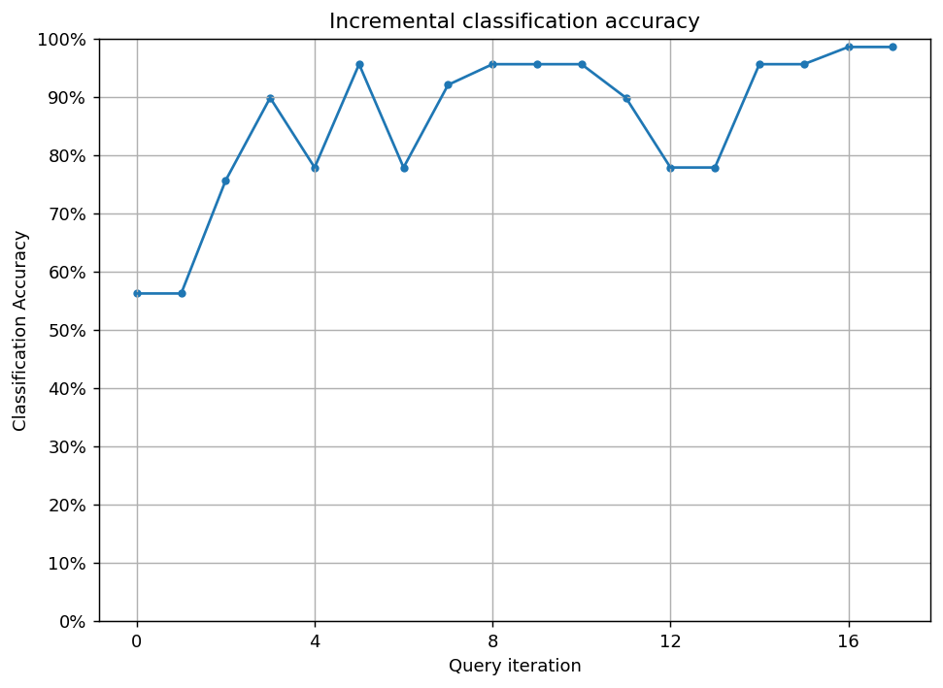
Project analysis slide 2
mushrooms dataset
Applying Active learning using entropy sampling strategy:

Slide 13
Project analysis slide 2
mushrooms dataset
Applying Active learning using margin sampling strategy:

Slide 14
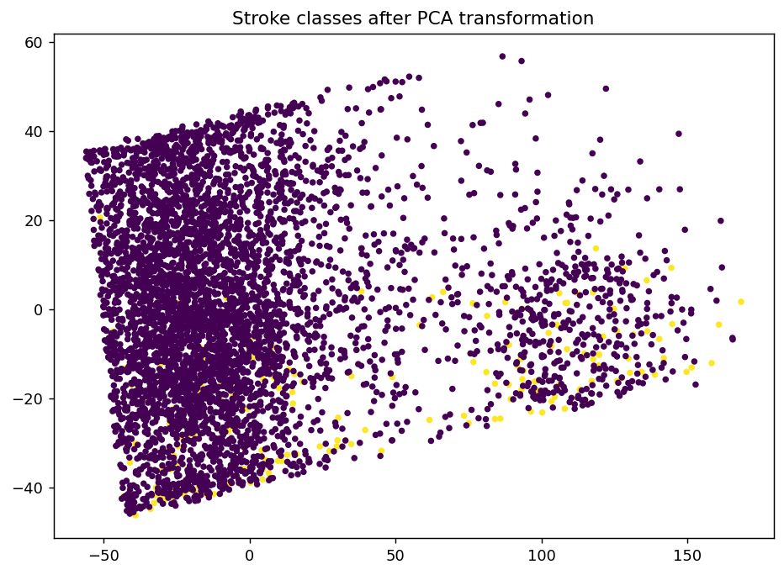
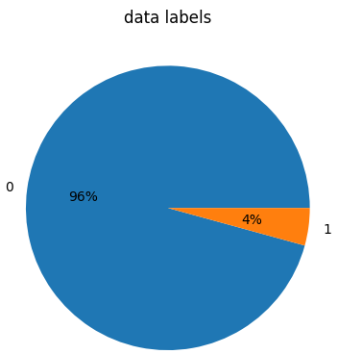
Project analysis slide 2
Stroke Prediction Dataset
Training size : 10
Estimator : XGBClassifier(gamma= 1,
learning_rate= 0.1,
max_depth= 7,
reg_lambda= 10,
scale_pos_weight= 3,
n_estimators=50)
Evaluation matrix : F1_score

Slide 15
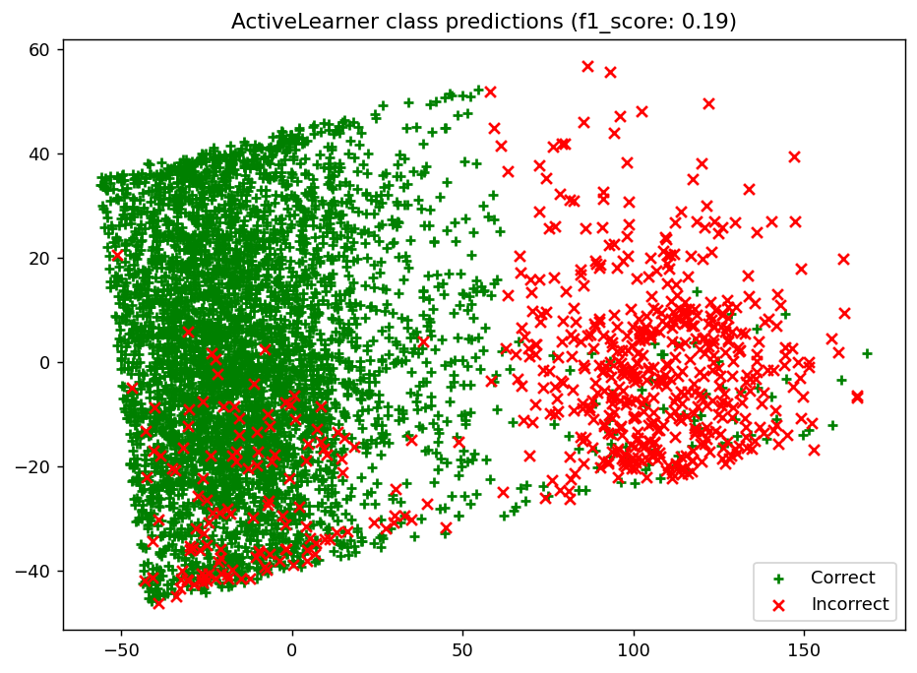
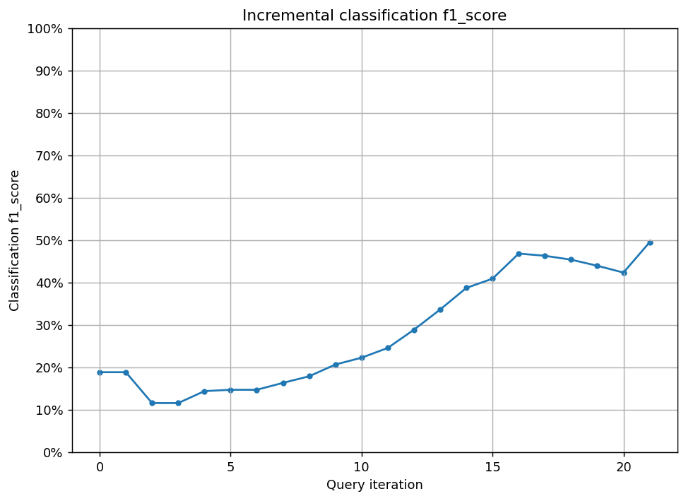
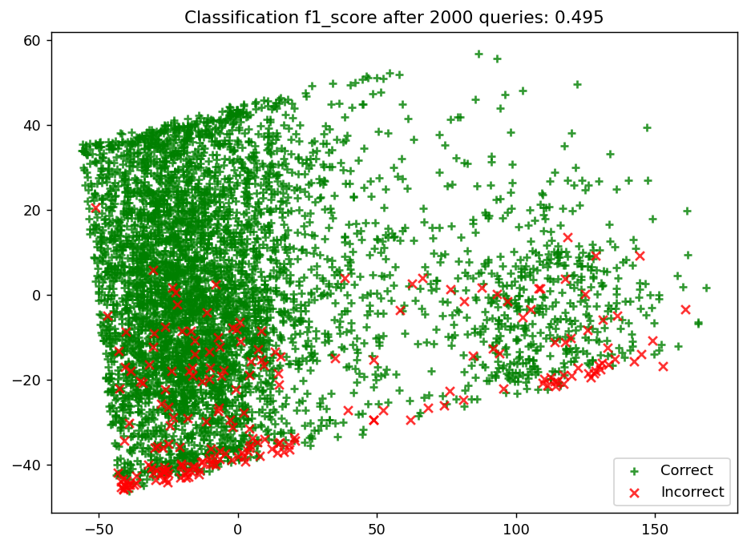
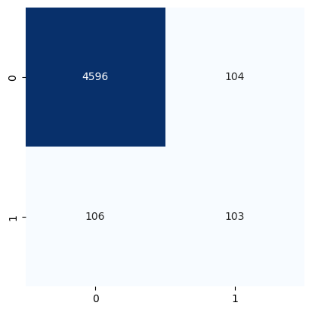
Project analysis slide 2
Stroke Prediction Dataset
Applying Active learning using uncertainty sampling strategy:

Slide 16
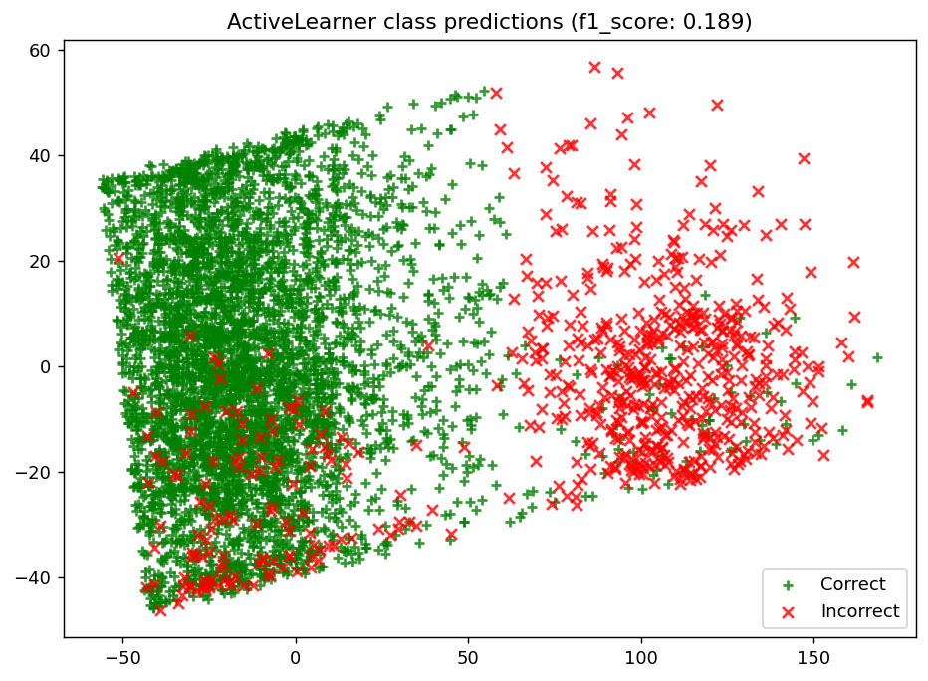
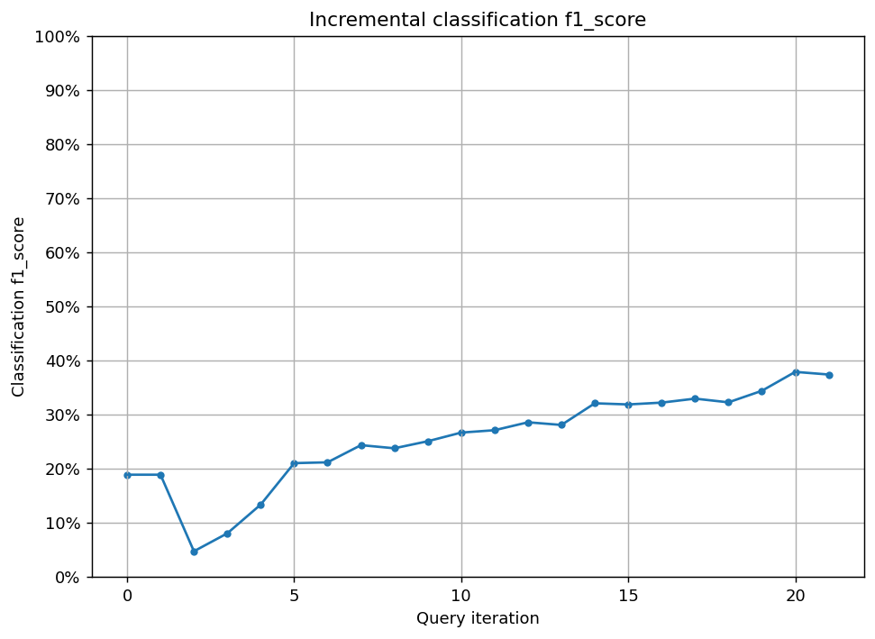
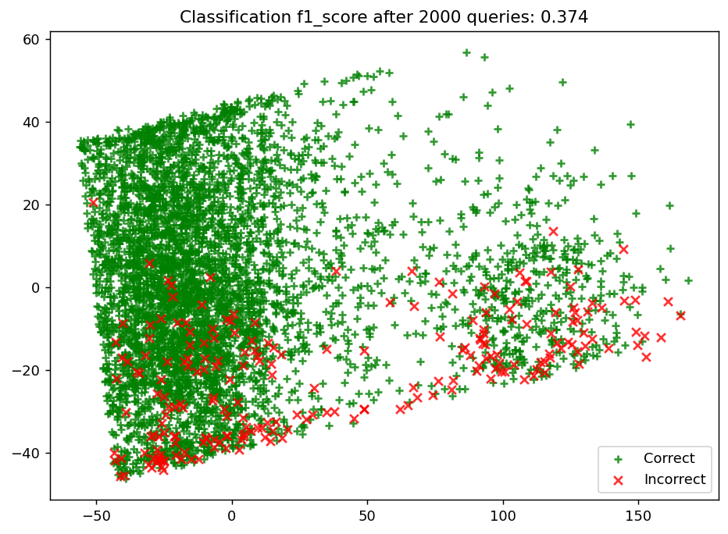

Project analysis slide 2
Stroke Prediction Dataset
Applying Active learning using random sampling strategy:

Slide 17
Project analysis slide 2
Stroke Prediction Dataset
Applying Active learning using entropy sampling strategy:

Slide 18
Project analysis slide 2
Stroke Prediction Dataset
Applying Active learning using margin sampling strategy:

Slide 19
Project analysis slide 2
Conclusion
Each strategy in the uncertainty family doesn’t vary much as we can't for sure say that one strategy is better than other overall however the active learning approaches as a whole is better in the factors of maintaining high score in evaluation metrics (accuracy in most cases) While reducing cost of computation, annotation and budget as we can run many models with many varieties in environment in parallel.

Slide 20
Thank You

